Slide 1
What is an
Exception?

Slide 2
What is an Exception?
Exceptional event - typically an error that occurs
during runtime
Cause normal program flow to be disrupted
Examples
– Divide by zero errors
– Accessing the elements of an array beyond its range
– Invalid input
– Hard disk crash
– Opening a non-existent file
– Heap memory exhausted

Slide 3
Exception Example
1 class DivByZero {
2 public static void main(String args[]) {
3 System.out.println(3/0);
4 System.out.println(“Pls. print me.”);
5 }
6 }

Slide 4
Example: Default Exception
Handling
Displays this error message
Exception in thread "main"
java.lang.ArithmeticException: / by zero
at DivByZero.main(DivByZero.java:3)
Default exception handler
– Provided by Java runtime
– Prints out exception description
– Prints the stack trace
Hierarchy of methods where the exception occurred
– Causes the program to terminate

Slide 5
What Happens When
an Exception Occurs?

Slide 6
What Happens When an Exception
Occurs?
When an exception occurs within a method, the
method typically creates an exception object and
hands it off to the runtime system
– Creating an exception object and handing it to the
runtime system is called “throwing an exception”
– Exception object contains information about the error, including its type and the state of the program when the error occurred

Slide 7
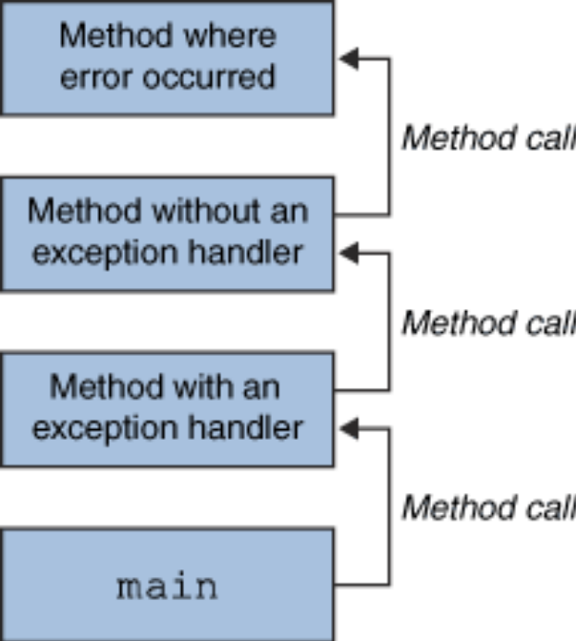
What Happens When an Exception Occurs?
The runtime system searches the call stack for a method that contains an exception handler

Slide 8
What Happens When an Exception Occurs? (Continued)
When an appropriate handler is found, the runtime system passes the exception to the handler
– An exception handler is considered appropriate if the
type of the exception object thrown matches the type that can be handled by the handler
– The exception handler chosen is said to catch the
exception.
If the runtime system exhaustively searches all the
methods on the call stack without finding an appropriate exception handler, the runtime system
(and, consequently, the program) terminates and
uses the default exception handler

Slide 9
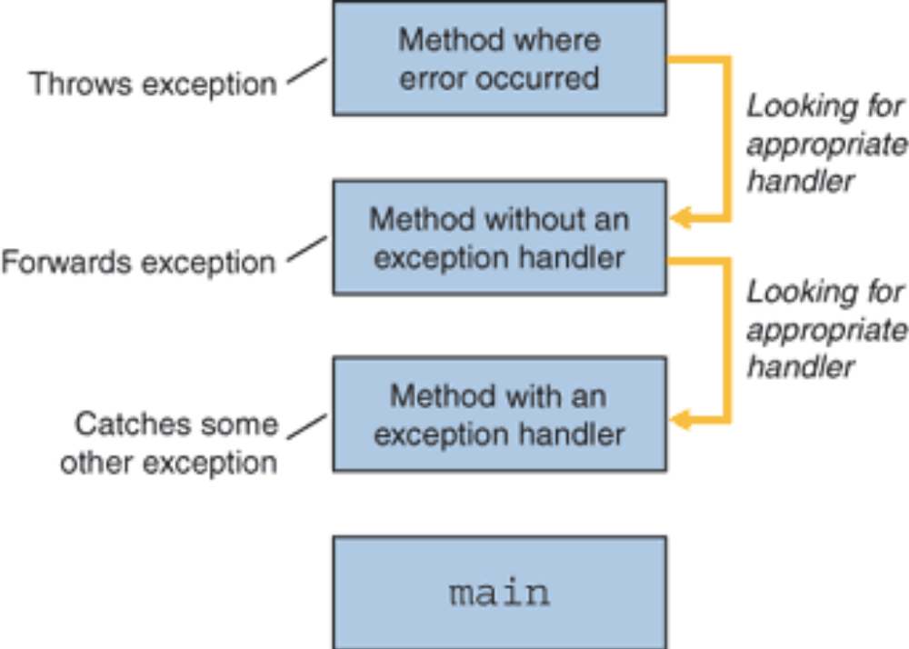
Searching the Call Stack for
an Exception Handler

Slide 10
Benefits of Exception
Handling Framework

Slide 11
Benefits of Java Exception
Handling Framework
Separating Error-Handling code from “regular” business logic code
Propagating errors up the call stack
Grouping and differentiating error types

Slide 12
Separating Error Handling Code from Regular Code
In traditional programming, error detection, reporting, and handling often lead to confusing spaghetti code
Consider pseudo code method here that reads an entire file into memory
readFile {
open the file;
determine its size;
allocate that much memory;
read the file into memory;
close the file;
}

Slide 13
Traditional Programming: No separation of error handling code
In traditional programming, To handle such cases, the readFile function must have more code to do error detection, reporting, and handling.
errorCodeType readFile {
initialize errorCode = 0;
open the file;
if (theFileIsOpen) {
determine the length of the file;
if (gotTheFileLength) {
allocate that much memory;
if (gotEnoughMemory) {
read the file into memory;
if (readFailed) {
errorCode = -1;
}
} else {
errorCode = -2;

Slide 14
} else {
errorCode = -3;
}
close the file;
if (theFileDidntClose && errorCode == 0) {
errorCode = -4;
} else {
errorCode = errorCode and -4;
}
} else {
errorCode = -5;
}
return errorCode;
}

Slide 15
Separating Error Handling Code from Regular Code (in Java)
Exceptions enable you to write the main flow of your code and to deal with the exceptional cases elsewhere
readFile {
try {
open the file;
determine its size;
allocate that much memory;
read the file into memory;
close the file;
} catch (fileOpenFailed) {
doSomething;
} catch (sizeDeterminationFailed) {
doSomething;
} catch (memoryAllocationFailed) {
doSomething;
} catch (readFailed) {
doSomething;
} catch (fileCloseFailed) {
doSomething;
}

Slide 16
Grouping and Differentiating Error Types
Because all exceptions thrown within a program are
objects, the grouping or categorizing of exceptions is a natural outcome of the class hierarchy
An example of a group of related exception classes in the Java platform are those defined in java.io —IOException and its descendants
– IOException is the most general and represents any type
of error that can occur when performing I/O
– Its descendants represent more specific errors. For
example, FileNotFoundException means that a file could
not be located on disk.

Slide 17
Grouping and Differentiating Error Types
A method can write specific handlers that can
handle a very specific exception
The FileNotFoundException class has no
descendants, so the following handler can handle only one type of exception.
catch (FileNotFoundException e) {
...
}

Slide 18
A method can catch an exception based on its
group or general type by specifying any of the exception's superclasses in the catch statement.
For example, to catch all I/O exceptions, regardless
of their specific type, an exception handler specifies
an IOException argument.
// Catch all I/O exceptions, including
// FileNotFoundException, EOFException, and so on.
catch (IOException e) {
...
}

Slide 19
Catching Exceptions
with try-catch

Slide 20
Catching Exceptions:
The try-catch Statements
  Syntax:
try {
<code to be monitored for exceptions>
} catch (<ExceptionType1> <ObjName>) {
<handler if ExceptionType1 occurs>
}
...
} catch (<ExceptionTypeN> <ObjName>) {
<handler if ExceptionTypeN occurs>
}

Slide 21
Catching Exceptions:
The try-catch Statements
1 class DivByZero {
2 public static void main(String args[]) {
3 try {
4 System.out.println(3/0);
5 System.out.println(“Please print me.”);
6 } catch (ArithmeticException exc) {
7 //Division by zero is an ArithmeticException
8 System.out.println(exc);
9 }
10 System.out.println(“After exception.”);
11 }
12

Slide 22
Catching Exceptions:
Multiple catch
1 class MultipleCatch {
2 public static void main(String args[]) {
3 try {
4 int den = Integer.parseInt(args[0]);
5 System.out.println(3/den);
6 } catch (ArithmeticException exc) {
7 System.out.println(“Divisor was 0.”);
8 } catch (ArrayIndexOutOfBoundsException exc2) {
9 System.out.println(“Missing argument.”);
10 }
11 System.out.println(“After exception.”);
12 }
13 }

Slide 23
Catching Exceptions:
Nested try's
class NestedTryDemo {
public static void main(String args[]){
try {
int a = Integer.parseInt(args[0]);
try {
int b = Integer.parseInt(args[1]);
System.out.println(a/b);
} catch (ArithmeticException e) {
System.out.println(“Div by zero error!");
}
//continued...

Slide 24
Catching Exceptions:
Nested try's
} catch (ArrayIndexOutOfBoundsException) {
System.out.println(“Need 2 parameters!");
}
}
}

Slide 25
Catching Exceptions:
Nested try's with methods
1 class NestedTryDemo2 {
2 static void nestedTry(String args[]) {
3 try {
4 int a = Integer.parseInt(args[0]);
5 int b = Integer.parseInt(args[1]);
6 System.out.println(a/b);
7 } catch (ArithmeticException e) {
8 System.out.println("Div by zero error!");
9 }
10 }
11 //continued...

Slide 26
Catching Exceptions:
Nested try's with methods
12 public static void main(String args[]){
13 try {
14 nestedTry(args);
15 } catch (ArrayIndexOutOfBoundsException e) {
16 System.out.println("Need 2 parameters!");
17 }
18 }
19 }

Slide 27
Catching Exceptions
with finally

Slide 28
Catching Exceptions:
The finally Keyword
Syntax:
try {
<code to be monitored for exceptions>
} catch (<ExceptionType1> <ObjName>) {
<handler if ExceptionType1 occurs>
} ...
} finally {
<code to be executed before the try block ends>
}
Contains the code for cleaning up after a try or a catch

Slide 29
Catching Exceptions:
The finally Keyword
Block of code is always executed despite of
different scenarios:
– Forced exit occurs using a return, a continue or a break
statement
– Normal completion
– Caught exception thrown
? Exception was thrown and caught in the method
– Uncaught exception thrown
? Exception thrown was not specified in any catch block in
the method

Slide 30
Catching Exceptions:
The finally Keyword
1 class FinallyDemo {
2 static void myMethod(int n) throws Exception{
3 try {
4 switch(n) {
5 case 1: System.out.println("1st case");
6 return;
7 case 3: System.out.println("3rd case");
8 throw new RuntimeException("3!");
9 case 4: System.out.println("4th case");
10 throw new Exception("4!");
11 case 2: System.out.println("2nd case");
12 }
13 //continued

Slide 31
Catching Exceptions:
The finally Keyword (Continued)
14 } catch (RuntimeException e) {
15 System.out.print("RuntimeException: ");
16 System.out.println(e.getMessage());
17 } finally {
18 System.out.println("try-block entered.");
19 }
20 }
21 //continued...

Slide 32
Catching Exceptions:
The finally Keyword (Continued)
22 public static void main(String args[]){
23 for (int i=1; i<=4; i++) {
24 try {
25 FinallyDemo.myMethod(i);
26 } catch (Exception e){
27 System.out.print("Exception caught: ");
28 System.out.println(e.getMessage());
29 }
30 System.out.println();
31 }
32 }
33 }

Slide 33
Throwing
Exceptions

Slide 34
Throwing Exceptions:
The throw Keyword
? Java allows you to throw exceptions (generate
exceptions)
throw <exception object>;
? An exception you throw is an object
– You have to create an exception object in the same wayyou create any other object
Example:
throw new ArithmeticException(“testing...”);

Slide 35
Example: Throwing Exceptions
1 class ThrowDemo {
2 public static void main(String args[]){
3 String input = “invalid input”;
4 try {
5 if (input.equals(“invalid input”)) {
6 throw new RuntimeException("throw demo");
7 } else {
8 System.out.println(input);
9 }
10 System.out.println("After throwing");
11 } catch (RuntimeException e) {
12 System.out.println("Exception caught:" + e);
13 }
14 }
15 }

Slide 36
Rules in Exception
Handling

Slide 37
Rules on Exceptions
A method is required to either catch or list all
exceptions it might throw
– Except for Error or RuntimeException, or their
subclasses
? If a method may cause an exception to occur but
does not catch it, then it must say so using the
throws keyword
– Applies to checked exceptions only
? Syntax:
<type> <methodName> (<parameterList>)
throws <exceptionList> {
<methodBody>
}

Slide 38
Example: Method throwing an
Exception
1 class ThrowingClass {
2 static void meth() throws ClassNotFoundException {
3 throw new ClassNotFoundException ("demo");
4 }
5 }
6 class ThrowsDemo {
7 public static void main(String args[]) {
8 try {
9 ThrowingClass.meth();
10 } catch (ClassNotFoundException e) {
11 System.out.println(e);
12 }
13 }
14 }

Slide 39
Checked and Unchecked
Exceptions
? Checked exception
– Java compiler checks if the program either catches or lists the
occurring checked exception
– If not, compiler error will occur
? Unchecked exceptions
– Not subject to compile-time checking for exception handling
– Built-in unchecked exception classes
? Error
? RuntimeException
? Their subclasses
– Handling all these exceptions may make the program cluttered
and may become a nuisance

Slide 40
How To Use Your Own Exceptions
1 class TestHateString {
2 public static void main(String args[]) {
3 String input = "invalid input";
4 try {
5 if (input.equals("invalid input")) {
6 throw new HateStringExp();
7 }
8 System.out.println("Accept string.");
9 } catch (HateStringExp e) {
10 System.out.println("Hate string!”);
11 }
12 }
13 }

